Slide 1
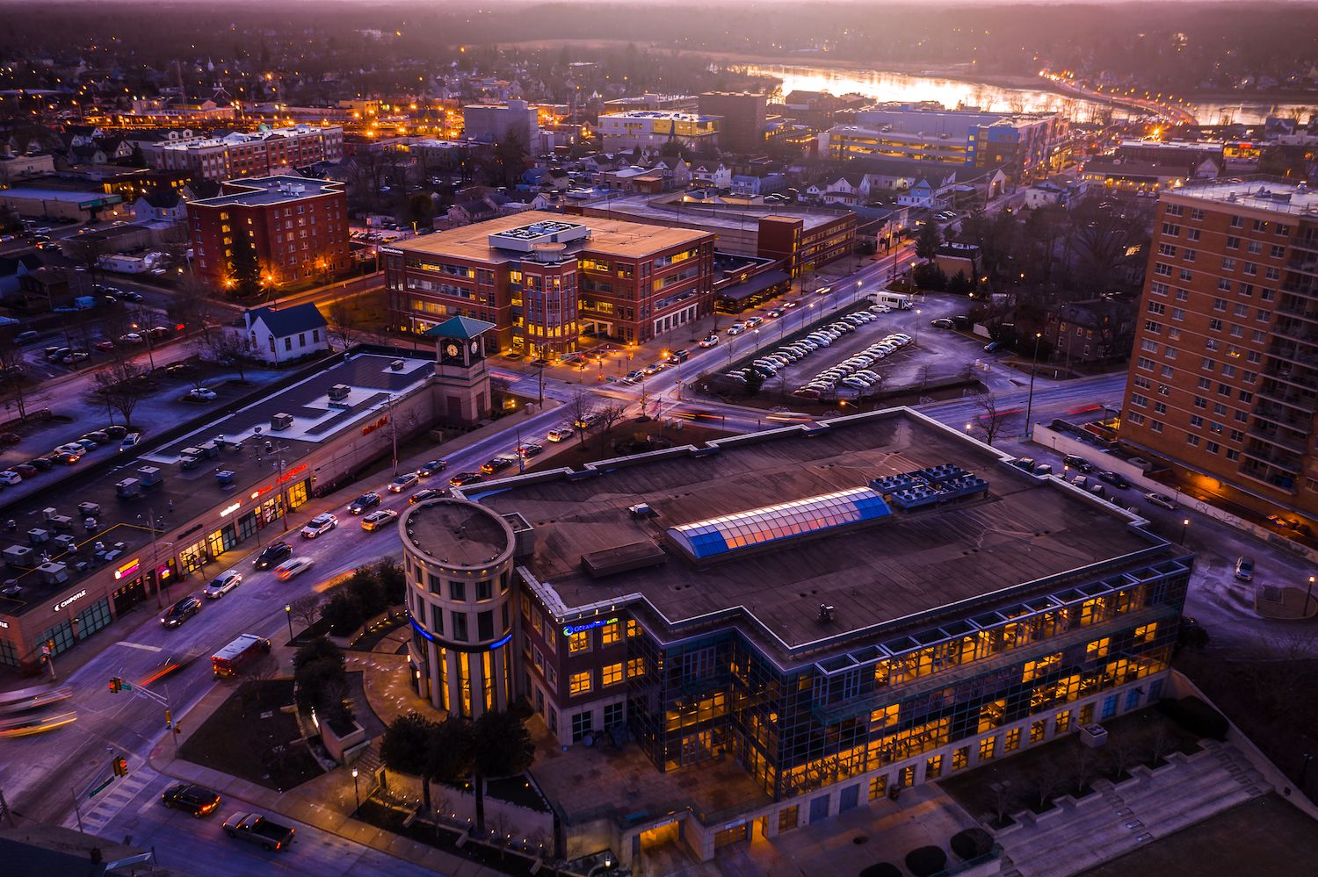
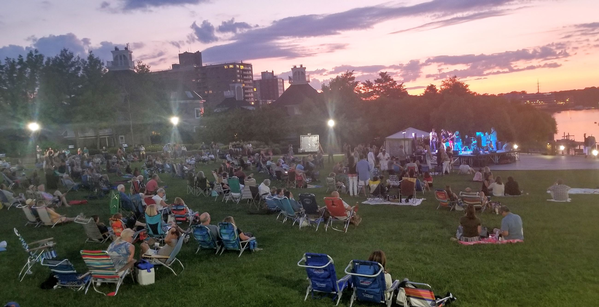
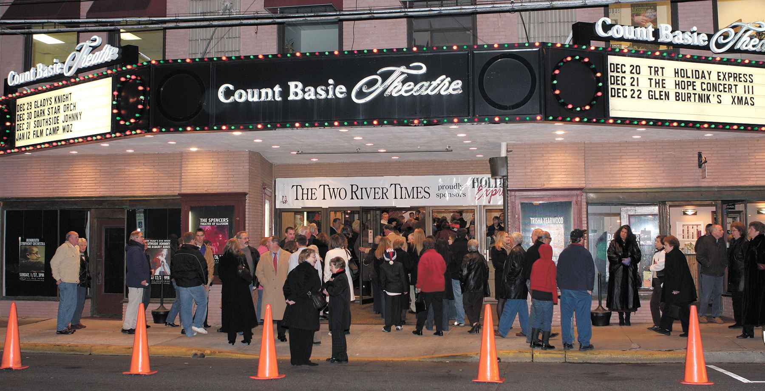
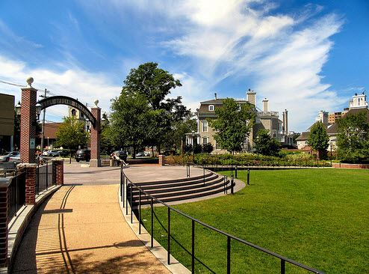
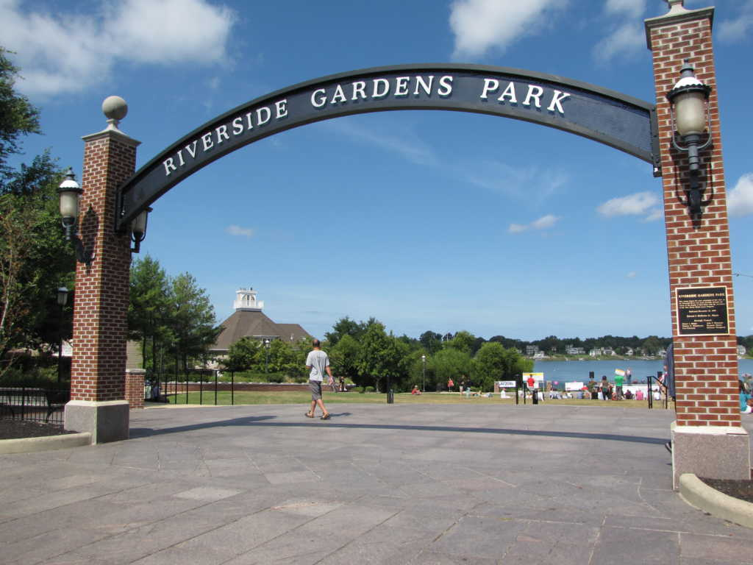
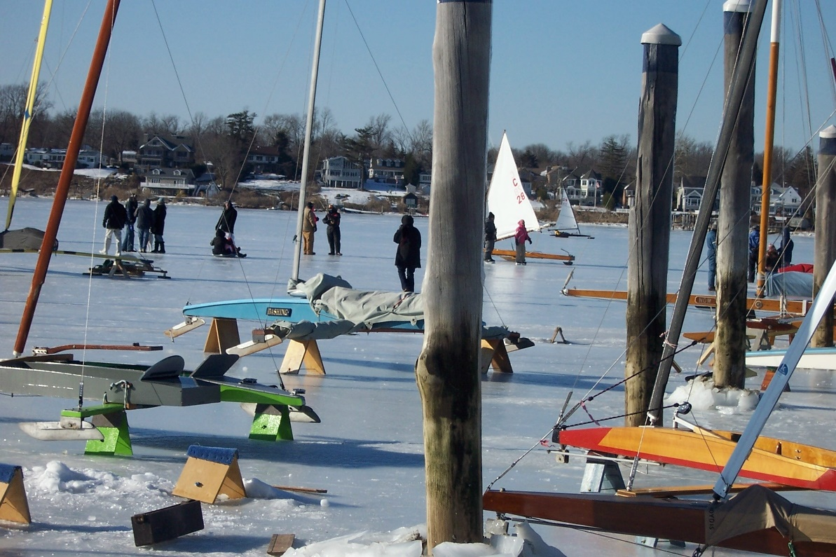
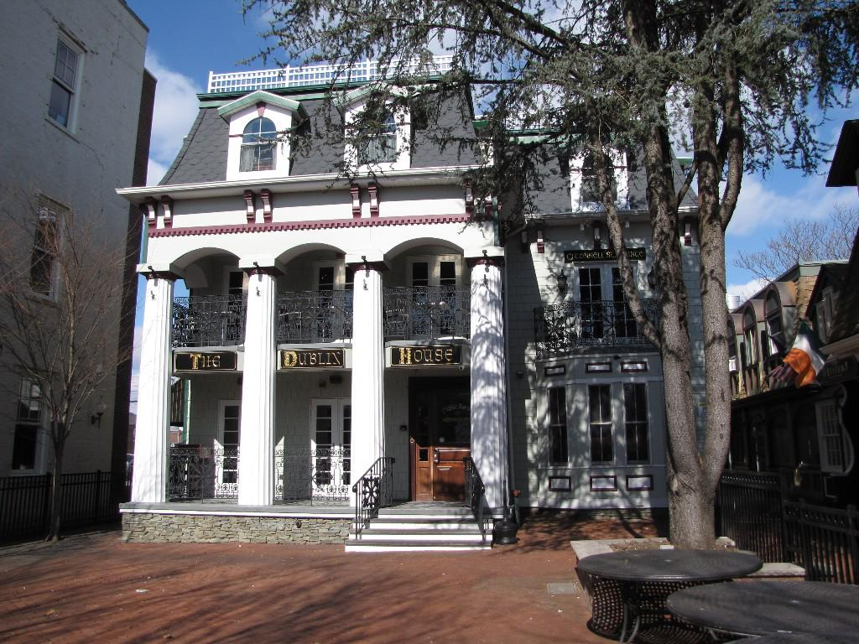
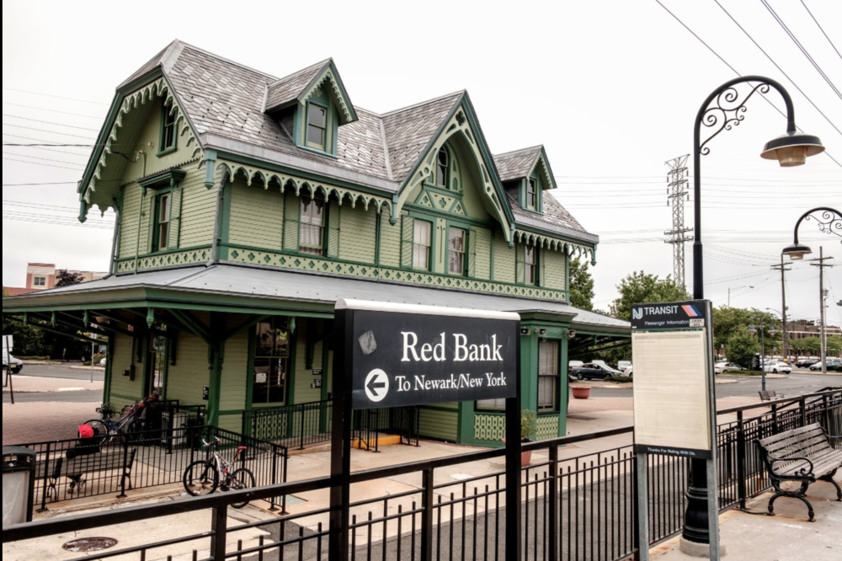
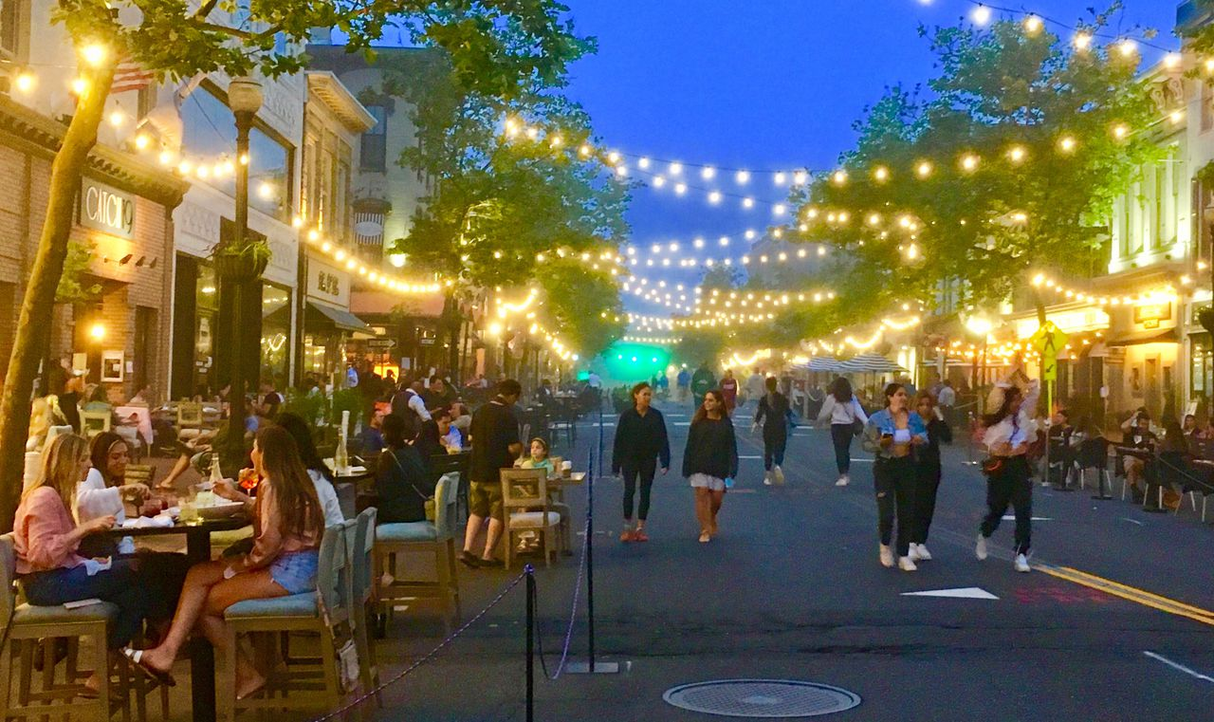
Borough of Red Bank
Budget 2024
Highlights Presentation

Slide 2

2024 Municipal Budget Presentation
Budget Process
Municipal Tax Levy
Property Tax Assessments
Budget Revenues
Budget Appropriations
Capital Projects
Utilities Overview
CAP and CAP Bank
Question/Answer

Slide 3

Budget Timeline
 | Milestones |  | 2023 Timeline |  | 2024 Timeline
 | Department Budgets |  | September-October |  | September - December
 | with Capital Projects Forecast
 | Preliminary Budget |  | February |  | February
 | Finance Committee Review/Signoff |  | March |  | March
 | Budget Introduction |  | April 26 |  | April 11th
 | Public Budget Presentation |  | May 4th |  | April 16
 | Budget Adoption |  | May 31st |  | May 9th

Slide 4

Budgeting Improvements
Long-term Budget Planning
  Strategic Plan Initiatives
  6 Year Infrastructure Plan
    Roads, Parks, Parking, Water/Sewer, Buildings
Departmental Goals
  Improved Customer Service Initiatives
  Cost Savings and/or Revenue Generation
  Process/Work efficiencies
Surplus Policy
Budget Objectives
Budget Schedule

Slide 5
Budget Guidelines
REVENUES
2024 Anticipated Budgeted Revenue can not exceed prior year realized revenues
Analyzed Prior Years Realized Revenues Trends
APPROPRIATIONS
By statute a municipality cannot spend more than budgeted for appropriations unless there is an emergency.
Analyzed Prior Years Paid/Charged with current requests
Transfers for budget shortages can not occur before November 1st
Every line must be fully funded at time of adoption.

Slide 6
Where Do Your Tax Dollars Go?
Total 2024 Tax Levy $57,394,173

Slide 7
How Is The Tax Levy Allocated?

Slide 8
Anticipated 2024 Total Tax Bill and Trends
All Taxing Authorities (Dollars)
 | 2024 |  |  | 2023 |  | Increase/
 | Rate | Amount of |  | Rate |  | (Decrease)
 | Per $100 | Taxes | % Portion | Per $100 | Amount | Rate | Amount
Borough | 0.490 | 14,996,509.88 | 26.6% | 0.502 | 14,574,278.24 | -0.005 | 422,231.64
Borough-Library | 0.034 | 1,054,215.46 | 1.9% | 0.033 | 949,512.17 | 0.002 | 104,303.29
School-Local | 0.653 | 19,971,418.44 | 35.2% | 0.674 | 19.579,822.00 | -0.021 | 391,596.44
School-Regional H.S. | 0.462 | 14,142,647.82 | 24.9% | 0.477 | 13,865,341.00 | -0.015 | 277,306.82
County | 0.217 | 6,649,411.52 | 11,7% | 0.224 | 6,519,030.90 | -0.007 | 130,380.62
Total | 1.858 | 56,814,203.12 | 100% | 1.911 | 55,488,384.31 | -0.046 | 1,519,401.81
Assessed value of your property is used to determine your share of the taxes that need to be raised for: School(s), County, and Municipality. Tax rate is determined by total amount of taxes to be raised $56,814,203.12 divided by Total Assessed Valuation of $3,057,883,276 divided by $100 which comes to a tax rate of 1.858 per $100 of valuation. Average residential value of $538,582 times . 01858 has a tax amount of $10,006.85, Municipal Portion $2,639.05, municipal tax increase of 103.74.
Borough Tax Increase of 1.38 cents. Each cent is $305,788.33
Borough is Under State LEVY CAP by $1,168,054.15

Slide 9
How Is The Allocation Determined?
2024 Property Tax Assessments
 | Property Type ( Amount) |  | 2024 Assessment Value |  | 2023 Assessment Value |  | % Change |  | 2024 Allocation % |  | 2023 Allocation % |  | Difference
 | Residential (3391) |  | $1,826,332,900 |  | $1,708,715,500 |  | 13.64% |  | 59.73% |  | 58.83% |  | .90%
 | Commercial (574) |  | $892,098,400 |  | $863,457,300 |  | 6.88% |  | 29.17% |  | 29.73% |  | -.56%
 | Apartment (36) |  | $278,574,000 |  | $273,796,100 |  | 1.75% |  | 9.11% |  | 9.43% |  | -.32%
 | Industrial / Vacant / Other (64) |  | $60,877,976 |  | $58,463,413 |  | 4.10% |  | 1.99% |  | 2.01% |  | - 0.02%
 | Total (4110) |  | $3,057,883,276 |  | $2,904,432,313 |  | 5.28% |  | 100.00% |  | 100.00% |  | 0.00%

Slide 10
Budget
2024
Municipal Tax Rate Summary 2020 - 2024
 | 2024 | 2023 | 2022 | 2021 | 2020
Amount to be Raised by Taxes | $14,996,509.88 | $14,574,278.24 | $14,186,719 | $14,637,479 | $14,118,509
Municipal Taxation Rate | .4900 | .5020 | .5328 | .6142 | .6189
Municipal Tax Rate Change | (.0120) | (.0308) | (.0814) | (.0047) | .0159
Assessed Valuations | 3,057,883,276 | 2,904,432,.13 | 2,662,844,382 | 2,383,028,687 | 2,286,363,015
Valuation Change % Change | 153,450,963 5.28% | 241,587,931 9.07% | 279,815,695 11.74% | 96,665,672 4.23% | 54,586,227 2.45%
Residential Tax Impact
2024 Residential Average Assessment | 538,582 | 505,244 | 469,876 | 406,067 | 383,981
Average Municipal Tax based on New Assessment | $2,639.05 | $2,535.31 | $2,503.50 | $2,494.23 | $2,376.24
Average Residential Municipal Tax Increase | $103.74 | $31.81 | $9.44 | $117.99 | $109.31
Average Municipal Tax % Increase | 2.90% | 1.27% | .380% | 4.965% | 4.822%
Total Taxation Rate (Estimated) | 1.858 | 1.911 | 2.007 | 2.237 | 2.272
Total Tax Rate Change | (.053) | (.096) | (.23) | (.035) | (.061)

Slide 11
Budget
2024
Budget Highlights
2024 Tax Levy Cap Bank Status
Tax Levy CAP Calculation
Prior Years Tax |  |  |  |  |  |  | 14,574,278.24
 | Adjustments:
 |  |  | Prior Year Recycling Tax |  |  |  | (22,000.00)
Net Prior Year's Tax Levy for CAP Calculation |  |  |  |  |  |  | 14,552,278.24
2% CAP Increase |  |  |  |  |  |  | 291,045.56
Allowable Tax Levy Prior to Exclusions and Ratables |  |  |  |  |  |  | 14,843,323.81
 | Exclusions: | Exclusions: Pension/Debt/Capital Improvements/Deferred Charges |  |  |  |  | 894,687.00
 | New Ratables - New Construction | New Ratables - New Construction |  |  |  |  | 66,572.23
 | Levy CAP Bank Applied | Levy CAP Bank Applied |  |  |  |  | 364,081.00
Maximum Allowable Amount of Taxation |  |  |  |  |  |  | 16,168,474.03
Proposed 2024 Municipal Tax Levy |  |  |  |  |  |  | 14,996,509.88
Over or (Under) 2% Levy CAP |  |  |  |  |  |  | (1,171,964,15)

Slide 12
Budget 2024
Budget Revenues

Slide 13
Budget
2024
Budget Highlights
Main Revenue Categories – Comparision 2023 to 2024
Revenue Classification |  | Change |  | 2024 | 2023
Fund Balance-Surplus |  | 20.11% |  | 3,700,000.00 | 3,080,500.00
Local Revenues |  | 18.47% |  | 5,432,243.01 | 4,568,296.49
State Aid |  | 0.50% |  | 2,035,669.00 | 2,025,586.00
Grants |  | 1,025% |  | 2,703,138.95 | 263,546.01
Delinquent Taxes |  | -12.50% |  | 525,000.00 | 600,000.00
Library Tax |  | 10.98% |  | 1,054,215.46 | 949,912.17
Municipal Tax |  | 2.90% |  | 14,996,509.88 | 14,574,278.24
Total Budget Revenues |  | 16.82% |  | 30,446,776.30 | 26,062,118.91

Slide 14
2024 Budget
Local Revenue Detail
 | 2024 | 2023 | Increase/-Decrease
Licenses:
Alcoholic Beverages | 90,800.00 | 90,800.00 | 0.00
Other | 55,000.00 | 41,500.00 | 13,500.00
Fees and Permits | 255,000.00 | 285,300.00 | -30,300.00
Fines and Costs:Municipal Court | 404,000.00 | 475,000.00 | -71,000.00
Interest and Costs on Taxes | 155,000.00 | 155,000.00 | 0
Interest on Investments and Deposits | 520,000.00 | 200,000.00 | 320,000.00
Uniform Construction Code Fees | 720,000.00 | 700,000.00 | 20,000.00
Code Enforcement Fees | 48,000.00 | 50,800.00 | -2,800.00
Shared Services
Township of Shrewsbury - Municipal Court | 7,000.00 | 7,000.00 | 0.00
Borough of Little Silver - Fire Services | 11,000.00 | 14,710.00 | -790.00
Red Bank Board of Education - Snow Plowing | 15,843.00 | 15,843.00 | 0.00
Township of Shrewsbury - EMS Services | 8,000.00 | 8,000.00 | 0.00
Red Bank Board of Education-School Resource Officer | 54,000.00 | 50,400.00 | 3,600..00
Deal/Loch Arbour-Finance Officer | 53,000.00 |  | 53,000.00
Utility Operating Surplus of Prior Year - Parking Utility/Water Sewer | 1,200,000.00 | 850,000.00 | 350,000.00
Uniform Fire Safety Act | 104,000.00 | 125,304.00 | -21,304.00
Hotel Occupancy Tax | 210,000.00 | 200,000.00 | 10,000.00
Franchise Tax Cable Television | 155,509.00 | 159,029.41 | -3,520.41
Payment in Lieu of Taxes - Housing Authority/River Street/Habcore | 190,000.00 | 190,000.00 | 0
Administrative Fee Off-Duty Police Services | 95,000.00 | 85,000.00 | 10,000.00
Reserve for Payment of Bonds | 172,673.00 | 172,673.00 | 0.00
Landlord Registration Fees | 14,000.00 | 15,000.00 | -1,000.00
RBC Field Rent | 130,000.00 | 130,000.00 | 0.00
Riverview Hospital Bed Tax | 457,000.00 | 442,000.00 | 15,000.00
Reserve for Municipal Relief Fund | 209,929.51 | 104,937.08 | 104,992.43
Reserve for Special Emergency Liability | 97,488.50 | 0 | 97,488.50
Total Local Revenues | 5,432,243.01 | 4,568,296.49 | 863,946.52

Slide 15
Surplus Outlook
  The number of Tax Appeals are like the previous year– residential and commercial
  Construction for UCC and other fees (revenue) should be increasing. Parking Revenues have been consistent
Use of Surplus-
  Surplus increases by Results of Operations which includes Excess Revenues, Excess Taxes Collected, Prior Budgets Cancelled and Miscellaneous Revenues Not Anticipated. In 2024, the amount of surplus used is $179,670 less than the amount closed out from operations in 2023. A good standard is not to use more than 2/3 (67%) of the beginning balance and have an ending balance of approximately 7.0-12% of the total budget $2,171,013.55/$30,446,776.30 (7.2%)
 | Beginning | ANITCIPATED | % used | Balance after | Year End Result | Ending
 | SURPLUS BAL | IN BUDGET | in budget | surplus applied | of Operations | SURPLUS BAL
2018 | 1,927,489 | 1,617,456 | 84% | 310,033.00 | 1,628,099 | 1,938,132
2019 | 1,938,032 | 1,482,000 | 76% | 456,032.00 | 2,983,078 | 3,439,110
2020 | 3,439,110 | 2,434,000 | 71% | 1,005,110.00 | 3,365,381 | 4,370,491
2021 | 4,370,491 | 3,390,313 | 78% | 980,178.00 | 3,931,215 | 4,911,393
2022 | 4,911,393 | 3,390,313 | 69% | 1,521,080.00 | 3,550,764 | 5,071,844
2023 | 5,071,844 | 3,080,500 | 61% | 1,991,344.00 | 3,879,670 | 5,871,015
2024 | 5,871,015 | 3,700,000 | 63% | 2,171,015.00 | , | ,

Slide 16
Budget 2024
Budget Appropritions

Slide 17
Budget
2024
Budget Highlights
Main Budget Categories – Comparison 2023 to 2024
Category |  | Change |  | 2024 Budget | 2023 Budget
Total Salary and Wages |  | 7.03% |  | 10,960.220.00 | 10,240,024.00
Grants |  | 443.73% |  | 3,205,609.95 | 721,296.01
Utilities |  | 3.81% |  | 545,500.00 | 525,500.00
Capital Improvements |  | 335% |  | 435,000.00 | 100,000.00
Solid Waste |  | 6.18% |  | 1,649,000.00 | 1,553,000.00
Debt Service |  | 8.60% |  | 3,388,172.00 | 3,119,916.00
Insurance |  | 2.61% |  | 3,512,412.35 | 3,422,910.13
Statutory Expenses-Pension/ Social Security Costs |  | 7.08% |  | 2,757,106.68 | 2,574,741.43
Other Operating Expenses |  | 5,53% |  | 2,577,740.50 | 2,442,760.49
Deferred Charges-Emergency/DCFT-unfunded |  | 596.30% |  | 222,834.00 | 32,000.00
Library Expenses |  | 18.58% |  | 364,515.46 | 307,412.17
Reserve for Uncollected Taxes |  | -.58% |  | 1,016,477.36 | 1,022,558.68
Total Budget |  | 16.80% |  | 30,446,776.30 | 26,062,118.91

Slide 18
Appropriation CAP detail
CAP CALCULATION |  |  |  |  |  |  |  |  |  | CAP CALCULATION
Total General Appropriations for 2023 |  |  |  |  |  | 25,911,556.24 |  |  |  | Allowable Operating Appropriations before
Cap Base Adjustment: |  |  |  |  |  | 174,693.00 |  |  |  |  | Additional Exceptions per (N.J.S.A. 40A:4-45.3) |  |  |  |  | 20,400,104.07
Subtotal |  |  |  |  |  | 26,086,249.24
Exceptions Less: |  |  |  |  |  |  |  |  |  | Additions:
 | Total Other Operations |  |  |  |  | 1,246,370.17 |  |  |  |  | New Construction (Assessor Certification) |  |  |  |  | 66,572.23
 | Total Uniform Construction Code |  |  |  |  |  |  |  |  |  | 2022 Cap Bank Utilized |  |  |  |  | 188,731.70
 | Total Interlocal Service Agreement |  |  |  |  | 92,243.00 |  |  |  |  | 2023 Cap Bank Utilized |  |  |  |  | 250,000.00
 | Total Additional Appropriations
 | Total Capital Improvements |  |  |  |  | 100,000.00
 | Total Debt Service |  |  |  |  | 3,119,916.00
 | Transferred to Board of Education |  |  |  |  |  |  |  |  | Total Additions |  |  |  |  |  | 505,303.93
 | Type I School Debt
 | Total Public & Private Programs |  |  |  |  | 570,733.34 |  |  |  | Maximum Appropriations within "CAPS" Sheet 19 @ |  |  |  |  | 2.5% | 20,905,408.00
 | Judgements
 | Total Deferred Charges |  |  |  |  | 32,000.00
 | Cash Deficit |  |  |  |  |  |  |  |  | Additional Increase to COLA rate. |  |  |  | 3.5%
 | Reserve for Uncollected Taxes |  |  |  |  | 1,022,446.17 |  |  |  |  | Amount of Increase allowable. |  |  | 1.0% |  | 199,025.41
 | Total Exceptions |  |  |  |  | 6,183,708.68
Amount on Which CAP is Applied |  |  |  |  |  | 19,902,540.56
2.5% | CAP |  |  |  |  | 497,563.51 |  |  |  | Maximum Appropriations within "CAPS" Sheet 19 @ |  |  |  |  | 3.5% | 21,104,433.41
Allowable Operating Appropriations before
 | Additional Exceptions per (N.J.S.A. 40A:4-45.3) |  |  |  |  | 20,400,104.07 |  |  |  | Total General Appropriations for Municipal Purposes |  |  |  |  |  | 20,759,041.53
 |  |  |  |  |  |  |  |  |  | (Sheet 19, H-1)
 |  |  |  |  |  |  |  |  |  | Over or (Under) Appropriations Cap |  |  |  |  |  | (345,391.88)

Slide 19
Budget 2024
Ratio of Debt to 3 year Equalized Valuations

Slide 20
Outstanding Debt 2023 to 2027
Current, Water/Sewer, Parking Capital
 | 2023 | 2024 | 2025 | 2026 | 2027
General Capital
Bond Principal/Interest | 12,987,000.00 | 11,212,000.00 | 9,350,000.00 | 8,050,000.00 | 6,690,000.00
Green Trust Loans Principal/Interest | 57,854.55 | 47,801.01 | 37,545.39 | 27,083.64 | 16,411.60
MCIA Capital Leases Principal/Interest | 3,933,464.40 | 3,070,968.80 | 2,363,509.80 | 1,658,022.20 | 1,130,515.00
Total Current | 16,978,318.95 | 14,330,769.81 | 11,751,055.19 | 9,735,105.84 | 7,836,926.60
Water/Sewer Capital
Bond Principal/Interest | 8,517,000.00 | 7,772,000.00 | 7,012,000.00 | 6,242,000.00 | 5,445,000.00
Environmental Infrastructure Loan Prin/Int | 3,313,495.09 | 3,094,162.81 | 2,864,830.53 | 2,635,498.25 | 2,406,165.97
MCIA Capital Leases Principal/Interest | 313,121.20 | 254,254.40 | 194,603.40 | 132,016.60 | 93,485.00
Total Water/Sewer | 12,143,616.29 | 11,120,417.21 | 10,071,433.93 | 9,009,514.85 | 7,944,650.97
Parking Capital
Bond Principal/Interest | 2,970,000.00 | 2,770,000.00 | 2,555,000.00 | 2,335,000.00 | 2,105,000.00
MCIA Capital Leases Principal/Interest | 4,414.40 | 2,776.80 | 1,886.80 | 961.20 | 0
Total Parking | 2,974,414.40 | 2,772,776.80 | 2,556,886.80 | 2,335,961.20 | 2,335,961.20

Slide 21
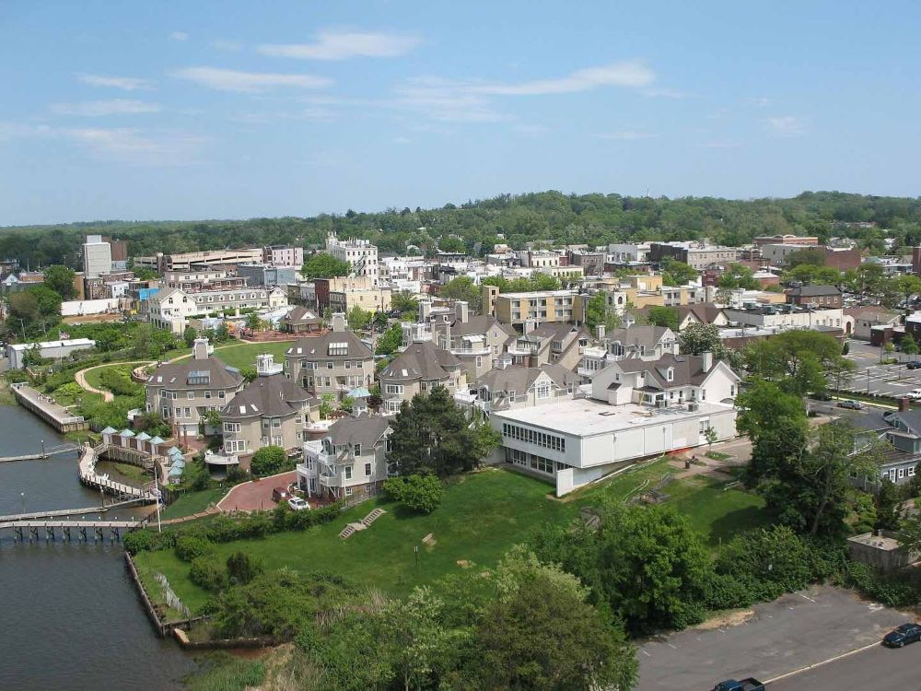
Budget 2024
Budget Highlights
Capital Budget Projects
Current Capital Projects:2024
Road Imrovements Alston Court, Hubbard Park & Allen Place, Harrison Ave, Linden Pl, Chestnut St, Boat Club Court
DOT Grant Safe Streets to Transit - Red Bank Station
Parks and Recreation Improvements
Count Basie Park Improvements
TAP Grant-Shrewsbury Avenue
Improvement to Marine Park
Improvements to Municipal Buildings
River Street Stormwater Improvements
Future Various ICapital Projects: 2025-2026
General Capital Projects
Improvements to DPW Facilities
Municipal Building Improvements
Various Infrastructure Improvements

Slide 22
2024 Budget
Water/Sewer Utility Budget 2024
 |  |  |  | Realized in
 | 2024 |  | 2023 | Cash in 2023
Surplus | 555,000.00 |  | 355,000.00 | 355,000.00
Rents | 6,675,000.00 |  | 6,500,000.00 | 6,692,046.00
Miscellaneous Revenues | 550,000.00 |  | 271,000.00 | 790,397.86
Total Revenues | 7,780,000.00 |  | 7,126,000.00 | 7,837,443.86
 |  |  |  | Paid or
 | 2024 |  | 2023 | Charged
Operating Expenses: Salary & Wages | 970,000.00 |  | 865,000.00 | 864.080.83
Other Expense | 4.843,462.00 |  | 4,487,284.00 | 4,441,100.29
Capital Improvements | 325,000.00 |  | 225,000.00 | 225,000.00
Debt Service | 1,352,465.10 |  | 1,352,465.10 | 1,349,008.82
Statutory Expenditures | 240.748.00 |  | 224.250.90 | 211,336.34
 | 7,780,000.00 |  | 7,126,000.00 | 7,090,526.24
Capital Projects: 2024 |  |  | Future Capital Projects: 2024-2027
Water Sewer |  |  | Water Sewer
Lead Service Line Replacement |  |  | Various Infrastructure Improvements
High Street Lift Station
Front Street /Carriage St lining
Bergen St/Alston Ct/ Hubbard WS Improvements

Slide 23
2024 Budget
Parking Utility Budget 2024
 |  |  | Realized in
 | 2024 | 2023 | Cash in 2023
Rents | 1,660,000.00 | 1,570,000.00 | 2,296,821,82
Interest on Investments | 40,000.00 | 8,000.00 | 81,499.95
Total Revenues | 1,700,000.00 | 1,578,000.00 | 2,378,321.77
 |  |  | Paid or
 | 2024 | 2023 | Charged
Operating Expenses: Salary & Wages | 436,000.00 | 370,000.00 | 335,992.01
Other Expense | 734,944.73 | 734,622.32 | 596,861.25
Capital Improvements | 125,000.00 | 75,000.00 | 42,596.00
Debt Service | 321,900.00 | 321,875.00 | 321,011.56
Statutory Expenditures | 82,155.27 | 76,502.68 | 66,680.96
 | 1,700,000.00 | 1,578,000.00 | 1,363,141.78
Capital Projects: 2024 |  | Future Capital Projects: 2025-2027
Parking |  | Parking
Various Infrastructure Improvements |  | Parking Meter/Kiosk Replacements
 |  | Parking Lot Crack Sealing

Slide 24
Future Planning Initiatives
Hold the line on Operating Expenses
Identify, implement, and invest in productivity enhancing management practices and equipment.
Consider Outsourcing Opportunities
Consider and evaluate Shared Services with another Borough and the County
Prepare the community for what lies ahead with greater transparency and communication.

Slide 25
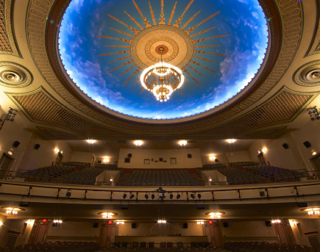
Budget
2024
Questions and Answers

